Slide 1
Poetry Poetry

Slide 2
Haiku Poem 1. Follows Form: 5 points
Line 1 --5 syllables
Line 2—7 syllables
Line 3—5 syllables
2. Addresses setting: 5 points
A traditional Japanese haiku is a three-line poem with seventeen syllables, written in a 5/7/5 syllable count. The first line will have 5 syllables, the second line will have 7, and the third line will have 5.
They are often about nature.
Example:
Hogwarts is magic.
Professors, creatures, and friends.
I really love it.

Slide 3
Limerick Poem 1. Follows Form: 5 points
-5 lines, Long, long, short, short, long
Rhyme scheme: aabba 2. Describes character physically: 5 points
3. Describes character behavior: 5 points
A limerick is a form of verse, usually humorous, in five-line with a strict rhyme scheme of AABBA, in which the first, second and fifth lines rhyme, while the third and fourth lines are shorter and share a different rhyme.
(The meter is anapestic, which means every third syllable is stressed. Just try to match the rhythm of the example.) Can't hear it? Here are more examples.
Example:
Harry Potter, the lightning-scarred boy,
Went to Hogwarts, and there he found joy.
He made enemies and friends
And with Snape made amends,
Though he never did like the Malfoys!

Slide 4
Acrostic Poem 1. Min 70 words: 5 points
2. Follows form: Acrostic spells a word down the side from the novel: 10 points
3. Includes major plot points, including climax: 10 points
An acrostic poem is a poem where certain letters in each line spell out a word or phrase. Typically, the first letters of each line are used to spell the message, but they can appear anywhere.
Example:
H-arry Potter was a special wizard,
A-lways worried about his friends
R-on met Harry at Hogwarts School R-iding broomsticks was so cool Y-ule Ball was like their senior prom
P-eople tried to kill him
O-thers would try to protect
T-ogether they went to defeat Voldemort
T-he battle ensued
E-veryone banded together
R-elief, after sweet victory

Slide 5
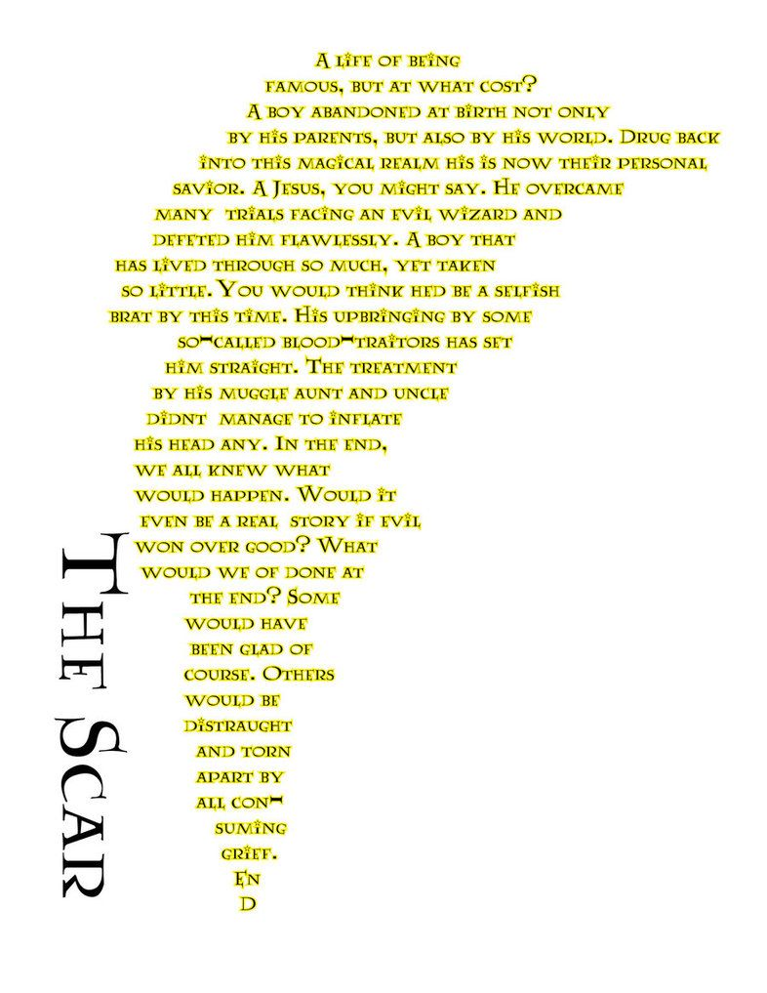
Concrete Poem 1. Min 70 words: 5 points
2. Follows form: Concrete is in the shape of something from the novel: 10 points
3. Includes major plot points, including climax: 10 points
Concrete poetry—sometimes also called ‘shape poetry’—is poetry whose visual appearance matches the topic of the poem. The words form shapes which illustrate the poem’s subject as a picture, as well as through their literal meaning.
Example:

Slide 6
Cinquain Poem 1. Follows form: 15 points
5 lines
Line 1: 2 syllables
Line 2: 4 syllables
Line 3: 6 syllables
Line 4: 8 syllables
Line 5: 2 syllables
Cinquains are five lines long. They have 2 syllables in the first line, 4 in the second, 6 in the third, 8 in the fourth line, and just 2 in the last line. Cinquains do not need to rhyme, but you can include rhymes if you want to.
Example:
Hello.
I miss you all.
Teaching you was awesome.
School is not the same anymore.
So hard.
A poem by Mrs. Hernandez to her students.

Slide 7
More Limericks! Listen for the meter.
The Tutor
by Carolyn Wells
The tutor who tooted the flute,
Tried to tutor two tooters to toot.
Said the two to the tutor:
"Is it harder to toot or
To tutor two tooters to toot?"
There Was an Old Man with a Beard
by Edward Lear
There was an Old Man with a beard, Who said, "It is just as I feared! Two Owls and a Hen, Four Larks and a Wren, Have all built their nests in my beard!”
Another Old Man?
There was an Old Man who supposed, That the street door was partially closed; But some very large rats, Ate his coats and his hats, While that futile old gentleman dozed.

